Slide 1

Conceptual models of NLS AB
Conceptual Modeling for Nordic Learning Solutions
Presented by: Adrian Nasrat, Tesnim Omran, Diana Dawidi, Ibrahim Mizher

Slide 2
Today we Will
Describe the organization using conceptual models
Show how goals, processes and data are connected
Present ER, DFD, OM and the Enterprise Model (EM)

Slide 3
Overview of the models
Objective Model (OM) – goals, problems, opportunities
Data Flow Diagram (DFD) – processes and information flows
Entity-Relationship Model (ER) – data structure
Enterprise Model (EM) – links between all models

Slide 4
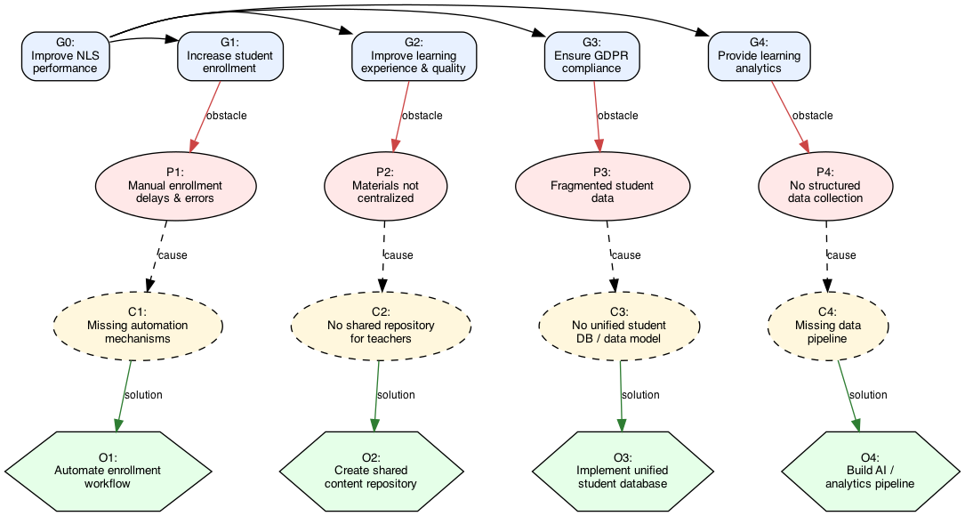
Objective model (OM)
High-level business goals
Mid- and low-level goals
Focus on learning quality and efficiency

Slide 5
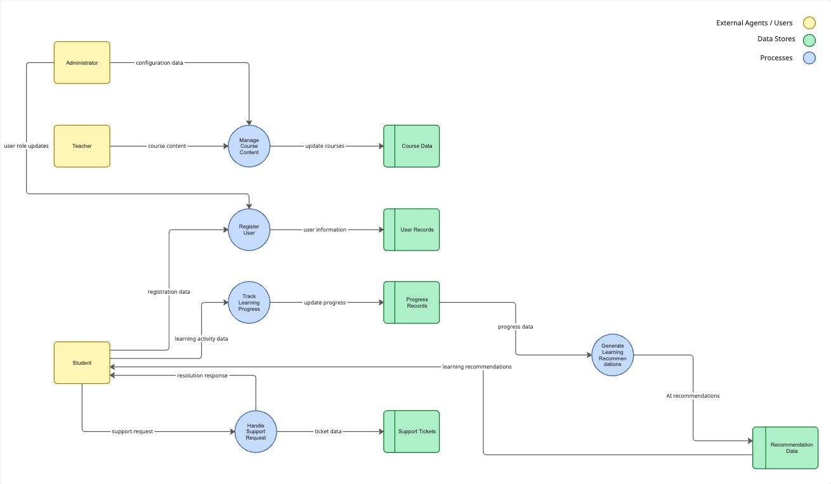
Data flow diagram (DFD)
External agents: students and teachers
Core processes: registration, tracking, recommendations
Data stores: learning and recommendation data

Slide 6
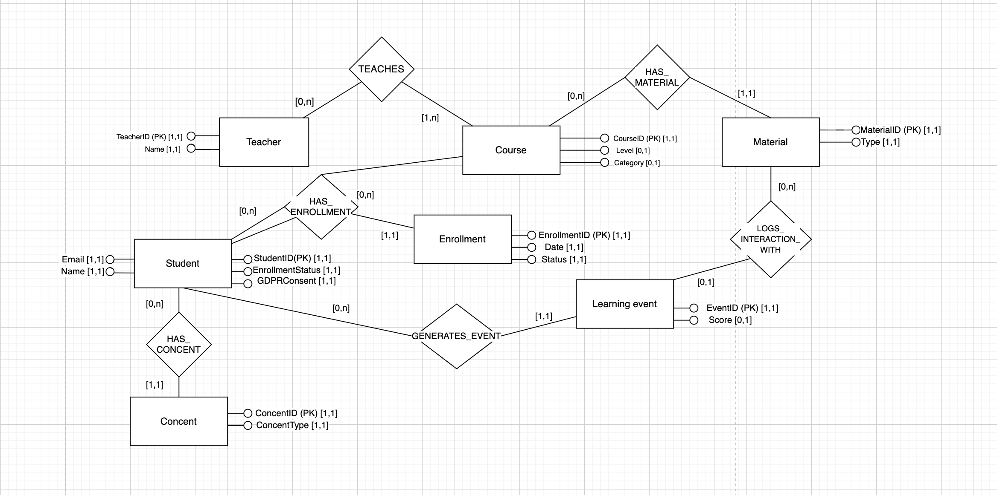
Entity-Relationship Model (ER)
Core entities: Student, Course, Learning event
Relationships describe how data is connected
Basis for database design

Slide 7
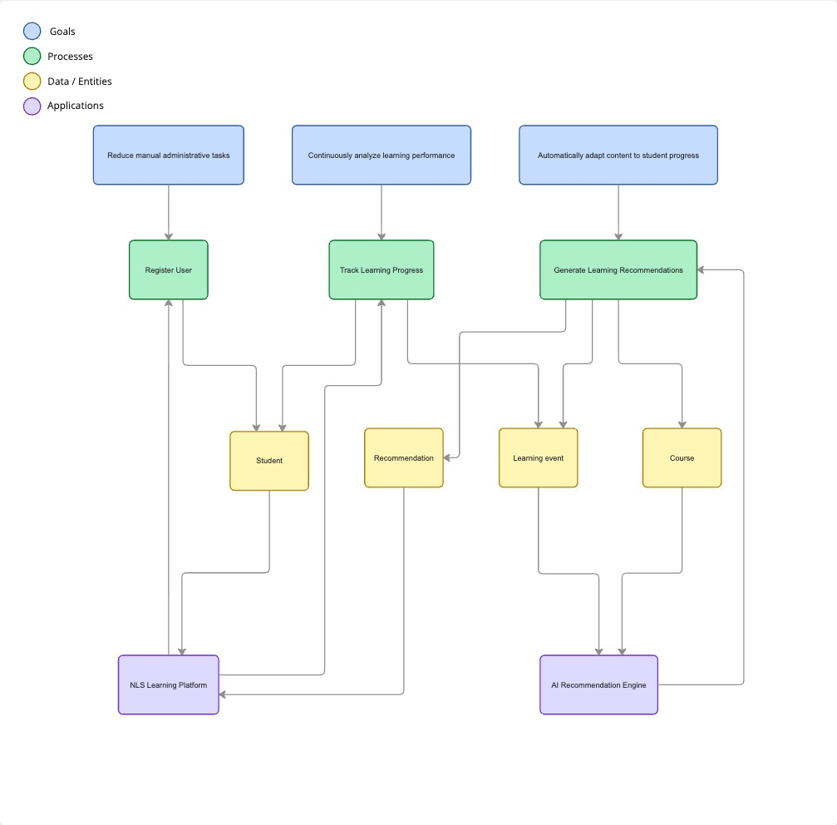
Enterprise Model (EM)
Goals → Processes → Data → Applications

Slide 8
Workflow
User registration and course enrollment
Learning activity and progress tracking
Analysis and generation of recommendations
Delivery of recommendations to the student

Slide 9
Conclusion
Conceptual models describe the system from different views
EM connects goals, processes, and data
Provides a clear enterprise-level understanding

